Slide 1

B .Tech – Mechanical Engineering
Minor Project Presentation (6th Sem)
on
“Experimental Analysis of Battery Thermal Management System (BTMS) using Heat Pipe”
Presented By:
Bhayani Darshan (2303031097068)
Ninama Monika (2303031097080)
Patel Dharmik (2303031097036)
Sai Kumar (2303031097065)
Supervisor:
Prof. Kamlesh Parmar
Assistant Professor,
Mechanical Engineering Department
PARUL INSTITUTE OF ENGINEERING AND TECHNOLOGY, PARUL UNIVERSITY
1.

Slide 2
BROAD OUTLINE
Motivation
Introduction
Literature Review
Summary
Research gap
Problem Definition
Aim & Objectives
Methodology
Work Plan
References
PARUL INSTITUTE OF ENGINEERING AND TECHNOLOGY, PARUL UNIVERSITY
2.

Slide 3

Motivation
Is an EV really less polluting?
other than Petrol, Diesel & CNG ?
Why We Need EV??
PARUL INSTITUTE OF ENGINEERING AND TECHNOLOGY, PARUL UNIVERSITY
3.

Slide 4
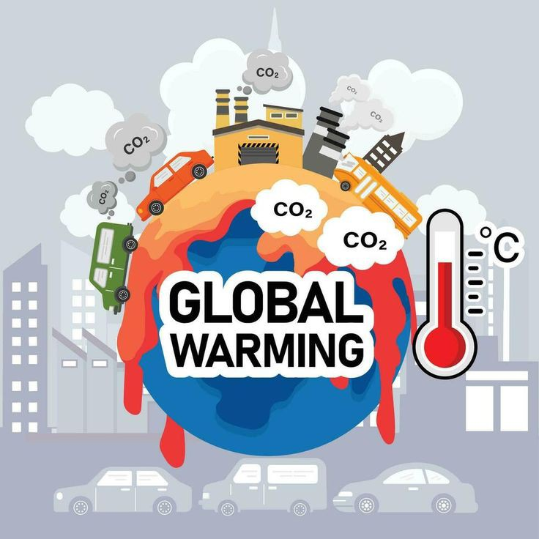
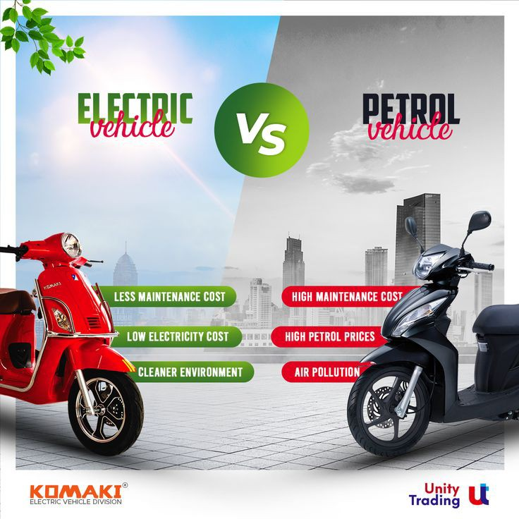
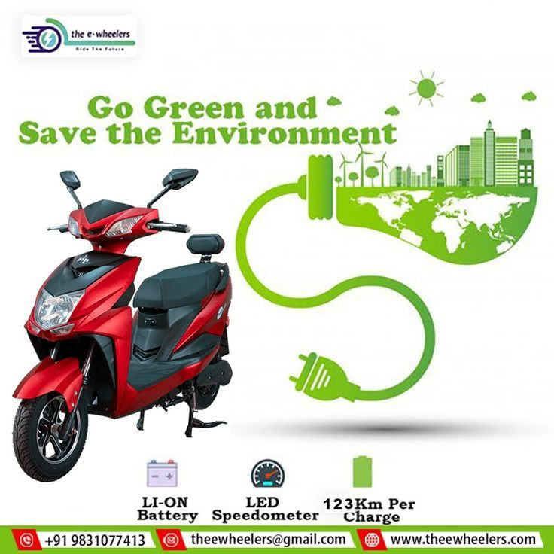
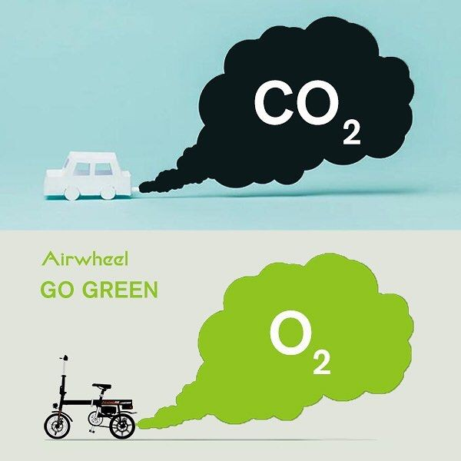

Introduction
"ज़िंदगी एक सफर है सुहाना, EV के साथ हर पल है पर्यावरण बचाना!"
PARUL INSTITUTE OF ENGINEERING AND TECHNOLOGY, PARUL UNIVERSITY
4.

Slide 5
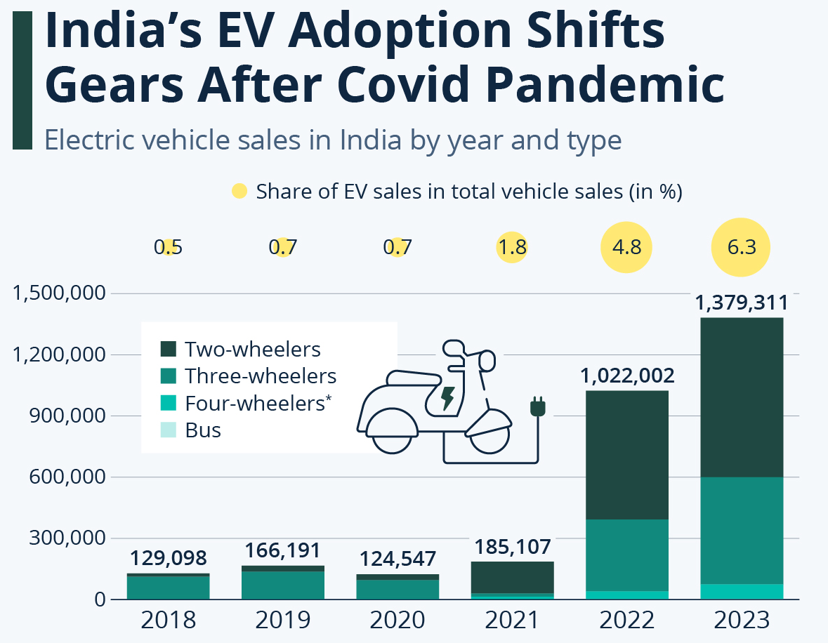
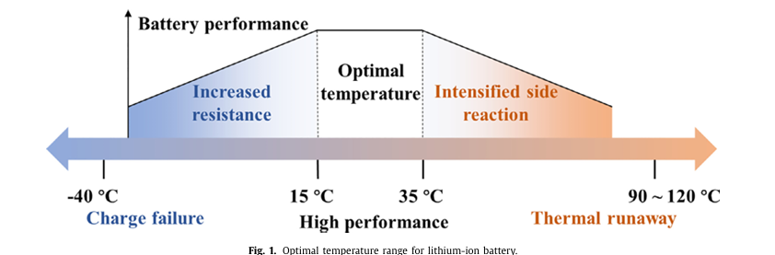
Introduction
Optimal Temperature Graph
Advances in thermal management systems for next-generation power batteries. (2021) [2]
EV Selling Graph
PARUL INSTITUTE OF ENGINEERING AND TECHNOLOGY, PARUL UNIVERSITY
5.

Slide 6
Introduction
1. Sustainable Mobility
Transition to EVs reduces environmental impact, eliminates vehicle emissions, and decreases noise pollution in populated areas.
2. Challenges in EVs
Li-ion batteries generate significant heat during high power output, leading to performance issues and accelerated aging.
3. Battery Thermal Management (BTMS)
Crucial for keeping battery temperature within optimal range (20–40°C).
Ensures battery efficiency, longevity, and safety.
4. Cooling Techniques
Air Cooling: Simple, but ineffective for high-power EVs.
Liquid Cooling: Efficient, but adds thermal resistance.
Direct Cooling BTMS: More effective for Li-ion batteries.
Innovative Cooling: Phase change materials and heat pipes being explored.
PARUL INSTITUTE OF ENGINEERING AND TECHNOLOGY, PARUL UNIVERSITY
6.

Slide 7
Introduction
5. Ideal BTMS Characteristics
Safe, compact, efficient, low-cost, and space-efficient for EVs.
6. Heat Pipe Cooling Solutions
Pulsating Heat Pipes (PHPs): Passive, low-cost, and energy-efficient. Maintain uniform temperature with phase change and pulsations.
Looped Heat Pipes (LHPs): Use acetone or alcohol to maintain safe battery temperatures below 50°C.
Standard Heat Pipes: Flattened U-shaped pipes maintain temperatures below 55°C at heat loads of 400 W.
7. Emerging Technologies
Solid-State Batteries: Higher energy density, but more prone to heat risks, making PHPs vital for cooling.
Experimental Study
A 3D PHP was tested on a 9-cell battery pack (9.6V, 5.4Ah), under varying power inputs and discharge curves, showing effective heat management.
PARUL INSTITUTE OF ENGINEERING AND TECHNOLOGY, PARUL UNIVERSITY
7.

Slide 8
Literature Review
TITLE | AUTHOR | OVERVIEW
Experimental study on the thermal performance of a battery thermal management system using heat pipes. (2021 ) [3] | Hussein Mbulu Yossapong Laoonual Somchai Wongwises | Heat Pipe-Based BTMS Summary Designed for EV battery thermal management under high heat. Maintained T_max ≤ 55°C and ΔT ≤ 5°C. Achieved >92% heat transfer efficiency.
Optimization of Thermal and Structural Design in Lithium‑Ion Batteries to Obtain Energy Efficient Battery Thermal Management System (BTMS): A Critical Review (2021) [4] | H. Fayaz et al. | The review focuses on optimizing thermal and structural parameters of Battery Thermal Management Systems (BTMSs) for Lithium-ion Batteries (LIBs). Key parameters include temperature control, uniformity, channel design, and pressure drop. BTMS methods studied include air cooling, PCM, mini-channels, heat pipes, and water cooling.
PARUL INSTITUTE OF ENGINEERING AND TECHNOLOGY, PARUL UNIVERSITY
8.

Slide 9
Literature Review
TITLE | AUTHOR | OVERVIEW
Analysis of a Battery Thermal Management System for Electric Vehicles using Heat Pipe Technology ( 2022 ) [5] | Eoin Guinan Joseph Mooney Johnathan Ottman Jeff Punch | Standard heat pipe works well at <40W; 42.9°C max at 40W. MBHP suitable for <20W heat loads. Increased flow reduces temperature but decreases cold plate efficiency. TEC model shows 15% accuracy in predicting temps.
A Review of the Parameters Affecting a Heat Pipe Thermal Management System for Lithium-Ion Batteries. (2022) [6] | Kittinan Boonma, Napol Patimaporntap, Hussein Mbulu, Piyatida Trinuruk, Kitchanon Ruangjirakit, Yossapong Laoonual, Somchai Wongwises. | Investigates the impact of ambient temperature, coolant temperature, and coolant flow rate on effective thermal management. Examines the role of heat generation rate, start-up time, and inclination angle of the heat pipe. Analyzes the influence of condenser and evaporator section lengths on system efficiency.
PARUL INSTITUTE OF ENGINEERING AND TECHNOLOGY, PARUL UNIVERSITY
09.

Slide 10
Literature Review
TITLE | AUTHOR | OVERVIEW
A Review on Recent Advances in Pulsating Heat Pipes (2022) [7] | Kamlesh Parmar Sumit Tripath Ajit Kumar Parwani | PHPs, invented in 1990, are wick-less heat pipes for efficient thermal management in electronics. Compact, cost-effective, and highly efficient with diverse applications like electronics cooling and energy systems. Closed-Loop (CLPHP) and Closed-End (CEPHP), operating via oscillating liquid-vapor motion.
Experimental Analysis of an Innovative Electrical Battery Thermal Management System. (2023) [8] | Luca Cattani Et al. | Lithium-ion batteries generate heat during high power delivery, risking performance loss and damage due to temperature issues. Proposed a three-dimensional pulsating heat pipe (PHP) for cooling. Experimental evaluation of PHP under varying power inputs. Tested with battery discharge load conditions
PARUL INSTITUTE OF ENGINEERING AND TECHNOLOGY, PARUL UNIVERSITY
10.

Slide 11
Literature Review
TITLE | AUTHOR | OVERVIEW
A comprehensive review on heat pipe based battery thermal management systems. (2023) [9] | Delika M. Weragoda Guohong Tian Arman Burkitbayev Kin-Hing Lo Teng Zhang | Heat pipes are promising for EV/HEV battery thermal management due to high conductivity and low maintenance. Challenges include performance under fluctuating heat, adverse conditions, and lack of simple models for predicting battery thermal behavior. Research on advanced heat pipe types and models shows promise, but commercialization requires addressing reliability and scalability issues.
Heat pipes in battery thermal management systems for electric vehicles: A critical review. (2023) [10] | Marco Bernagozzi , Anastasios Georgoulas, Nicolas Miche , Marco Marengo | EVs reduce emissions, and BTMS ensures battery performance and lifespan. Current BTMS (air and liquid cooling) have limitations. Heat Pipes offer potential for efficient heat removal in BTMS. Future focus: ambient temperature, scalability, and eco-friendly fluids.
PARUL INSTITUTE OF ENGINEERING AND TECHNOLOGY, PARUL UNIVERSITY
11.

Slide 12
Literature Review
TITLE | AUTHOR | OVERVIEW
Effect of Heat Pipe’s Configuration in Managing the Temperature of EV Battery. (2023) [11] | Faiza M. Nasir M.Z. Abdullah Mohd Azmi Ismail | Heat pipe diameter: 6–12 mm. Number of heat pipes: 2–10. Type: Straight heat pipes. Battery heat generation rate: 10–30W.
Thermal performance comparison of closed loop pulsating heat pipe with DI water and Al2O3/DI nanofluid.(2024) [12] | Kamlesh Parmar et al. | Experimental studies were conducted on a Closed-Loop Pulsating Heat Pipe (CLPHP) to compare its thermal performance using working fluids with and without nanoparticles. The thermal resistance was evaluated under varying operating conditions, focusing on the impact of nanoparticle addition on heat transfer efficiency. Nanofluids, particularly Al₂O₃-based, demonstrated enhanced heat transfer properties, with reduced thermal resistance observed at optimal filling ratios (notably 70% FR).
PARUL INSTITUTE OF ENGINEERING AND TECHNOLOGY, PARUL UNIVERSITY
12.

Slide 13
Summary
Purpose: Maintains optimal battery temperature for performance, safety, and lifespan.
Structure: Sealed tube with working fluid and wick for heat transfer.
Working: Heat absorbed → Fluid vaporizes (evaporator). - Vapor condenses → Heat released (condenser). - Liquid returns via wick (capillary action).
Advantages: High thermal efficiency and uniformity. - Passive, compact, and lightweight.
Applications:-Dissipates heat in EV and energy storage battery packs. Combats hotspots and ensures even temperature.
Types: Cylindrical, flat, and loop heat pipes for diverse designs.
Challenges: Requires optimized design and material selection. Higher costs for large-scale use.
PARUL INSTITUTE OF ENGINEERING AND TECHNOLOGY, PARUL UNIVERSITY
13.

Slide 14
Research Gap
In this project are using Lithium-ion battery, in future we can use other battery also.
For which the battery is overheating we will design a heat pipe for the same.
For better performance and average of the we can use other battery.
On the other hand some are using cold fluid we can also use force/free air, for cooling battery.
Because if we will use water the performance/average of the EV will be minimum and we have to make some space to store water.
PARUL INSTITUTE OF ENGINEERING AND TECHNOLOGY, PARUL UNIVERSITY
14.

Slide 15

Problem Definition
The existing problem which are facing in the EV vehicles which we are aiming to solve.
Battery Thermal Management Issues
Overheating: Poor thermal management of Li-ion batteries can lead to excessive heat generation, causing the battery to overheat and potentially catch fire.
Inadequate Cooling: Without effective cooling systems (e.g., liquid cooling, heat pipes), battery temperatures may rise above safe limits, triggering thermal runaway.
2. Overcharging and Fast Charging
Charging at High Rates: Charging at high speeds or overcharging can cause internal battery heat buildup, leading to fires.
Incompatible Chargers: Using inappropriate or non-certified chargers can damage the battery, causing overheating.
PARUL INSTITUTE OF ENGINEERING AND TECHNOLOGY, PARUL UNIVERSITY
15.

Slide 16
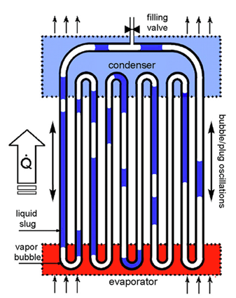
Problem Definition
Solution:-
Improved Thermal Management: Adoption of better cooling solutions to maintain battery temperature within safe limits.
Charging Safeguards: Enhanced charging protocols and safety features to prevent overcharging and overheating.
Safer Storage: Proper guidelines for battery storage, avoiding extreme temperatures and physical damage.
Fins: Fins are used to manage heat, improve cooling, and optimize performance in various mechanical systems
Heat Pipes: A heat pipe is a device that transfer heat using the evaporation and condensation of a liquid inside a sealed tube. It efficiently moves heat from a hot area (evaporator) to a cooler area (condenser) with minimal temperature difference, often using a wick structure to return the liquid. Heat pipes are used in applications like electronics cooling and thermal management due to their high efficiency and compact design.
Air: Free Air and Forced Air refer to types of airflow used in various systems for cooling, ventilation, or combustion.
By addressing these factors, the risk of battery fires in EV bikes can be minimized.
Fig:- Pulsating Heat Pipe (2022) [1]
PARUL INSTITUTE OF ENGINEERING AND TECHNOLOGY, PARUL UNIVERSITY
16.

Slide 17
Aim & Objectives
Objectives :-
To identify the battery system/ battery pack.
To design and manufacture a heat pipe.
Performance enhancement of battery cooling for EV’S using heat pipe.
PARUL INSTITUTE OF ENGINEERING AND TECHNOLOGY, PARUL UNIVERSITY
17.

Slide 18
Methodology
Problem Identification:-
Analyze thermal challenges in battery system, such as overheating, reduced efficiency,and uneven temperature distribution.
Define objectives: Improve thermal regulation, enhance battery lifespan, and increase system efficiency.
2. System Design:-
Heat Pipe Design: Select pipe materials (e.g., copper, aluminum), working fluids (e.g., water, acetone), and wick structure (e.g., sintered metal, grooves).
Integration: Position heat pipe evaporators near heat sources and condensers near dissipation areas.
Battery Module Integration: Ensure proper contact between the heat pipe and battery cells for efficient heat transfer.
3. Prototype Fabrication:-
Build the BTMS prototype with integrated heat pipes and required thermal interface materials (e.g., thermal grease, pads).
Include sensors (e.g., thermocouples) for real-time monitoring of temperature and heat flux.
PARUL INSTITUTE OF ENGINEERING AND TECHNOLOGY, PARUL UNIVERSITY
18.

Slide 19
Methodology
4. Experimental Setup:-
Design a test rig to simulate battery operation under varying thermal loads.
Use controlled heating systems to mimic real-world battery usage conditions.
5. Data Collection:-
Measure critical parameters: battery surface temperature, heat pipe performance, thermal uniformity, and system efficiency.
Record data under different operating conditions, such as varying heat loads and ambient temperatures.
6. Performance Analysis:-
Compare experimental results with simulation predictions.
Assess metrics such as heat dissipation rate, thermal resistance, and temperature uniformity.
7. Validation and Optimization:-
Validate experimental results against benchmarks or industry standards.
Optimize the system design for scalability, cost-effectiveness, and environmental impact.
8. Report Findings
Summarize strengths, limitations, and areas for improvement.
Propose future research directions, such as employing eco-friendly materials or enhancing system scalability.
PARUL INSTITUTE OF ENGINEERING AND TECHNOLOGY, PARUL UNIVERSITY
19.

Slide 20
Work Plan
Task | Description
Research and Literature Review | Investigate existing BTMS technologies, focusing on heat pipes.
Material Selection | Choose heat pipe materials, working fluids, and wick structures.
Design of Heat pipe | Design heat pipe integration with the battery system
Prototype Fabrication | Build the BTMS prototype, integrate heat pipes with battery modules.
Experimental Setup | Set up the testing rig, including temperature sensors and data acquisition.
Testing and Data Collection | Conduct experiments under different thermal loads; record temperature and performance data.
Data Analysis and Reporting | Analyze the experimental data, compare with simulations, and optimize design.
Final Presentation and Report | Prepare a detailed report and presentation of findings, conclusions, and recommendations.
PARUL INSTITUTE OF ENGINEERING AND TECHNOLOGY, PARUL UNIVERSITY
20.

Slide 21
Reference
S. Khandekar, A.P. Gautam, P.K. Sharma, Multiple quasi-steady states in a closed loop pulsating heat pipe, Int. J. Therm. Sci. 48 (2009) 535–546, https://doi.org/ 10.1016/j.ijthermalsci.2008.04.004.
D. Ouyang, J. Weng, M. Chen, J. Wang, Impact of high-temperature environ- ment on the optimal cycle rate of lithium-ion battery, J. Energy Storage 28 (2020) 101242, doi: 10.1016/j.est.2020.101242 .
King Mongkut’s University of Technology Thonburi, Bangmod, Bangkok, Thailand. E-mail address: somchai.won@kmutt.ac.th (S. Wongwises). https://doi.org/10.1016/j.csite.2021.101029
Archives of Computational Methods in Engineering (2022) 29:129–194 https://doi.org/10.1007/s11831-021-09571-0
Eoin Guinan1,2, Joseph Mooney3, Johnathan Ottman4, Jeff Punch1,2, Vanessa Egan1,2 1School of Engineering, Bernal Institute, University of Limerick Castletroy, Limerick, Ireland DOI: 10.11159/htff22.161
Boonma, K.; Patimaporntap, N.; Mbulu, H.; Trinuruk, P.; Ruangjirakit, K.; Laoonual, Y.; Wongwises, S. A Review of the Parameters Affecting a Heat Pipe Thermal Management System for Lithium-Ion Batteries. Energies 2022, 15, 8534. https://doi.org/10.3390/ en15228534
Lecture Notes in Intelligent Transportation and Infrastructure ISBN 978-981-16-7659-8 ISBN 978-981-16-7660-4 (eBook) https://doi.org/10.1007/978-981-16-7660-4
: Cattani, L.; Malavasi, M.; Bozzoli, F.; D’Alessandro, V.; Giammichele, L. Experimental Analysis of an Innovative Electrical Battery Thermal Management System. Energies 2023, 16, 5071. https://doi.org/10.3390/en16135071
Delika M. Weragoda a a , Guohong Tian a , * , Arman Burkitbayev a , Kin-Hing Lo a , Teng Zhang School of Mechanical Engineering Sciences, Faculty of Engineering and Physical Sciences, University of Surrey, Guildford GU2 7XH, UK b Breathe Battery Technologies Ltd, Office 7, 35 – 37 Ludgate Hill, London, UK https://doi.org/10.1016/j.applthermaleng.2023.120070
PARUL INSTITUTE OF ENGINEERING AND TECHNOLOGY, PARUL UNIVERSITY
21.

Slide 22
Reference
10. Marco Bernagozzi * , Anastasios Georgoulas, Nicolas Mich´ e, Marco Marengo Advanced Engineering Centre, University of Brighton, Brighton, UK E-mail address: M.Bernagozzi3@brighton.ac.uk (M. Bernagozzi). https://doi.org/10.1016/j.applthermaleng.
11. Faiza Mohamed Nasir1,*, Mohd Zulkifly Abdullah2, Mohd Azmi Ismail2 1 2 Mechanical Section, UniKL Malaysian Spanish Institute, Kulim Hi-Tech Park, 09000 Kulim, Kedah, Malaysia School of Mechanical Engineering, Kampus Kejuruteraan, Universiti Sains Malaysia, Nibong Tebal, Pulau Pinang, Malaysia https://doi.org/10.37934/cfdl.15.3.2234
12. Recent Advances in Mechanical Infrastructure AIP Conf. Proc. 2960, 040005-1–040005-8; https://doi.org/10.1063/5.0183494
PARUL INSTITUTE OF ENGINEERING AND TECHNOLOGY, PARUL UNIVERSITY
22.

